Slide 1
Demonstrative pronouns
UNIT 2A

Slide 2

Agenda
Review: Numbers from 10 to 100
Tricky words
Vocabulary: Nouns
Vocabulary: Lost property
Technology II
Reading: Shopping for electronics
Survey

Slide 3

Learning objectives
The student will be able to learn more vocabulary about Technology.
The student will be able to know the use of demonstrative pronouns.
The student will be able to practice the nouns: Singular and Plural.

Slide 4
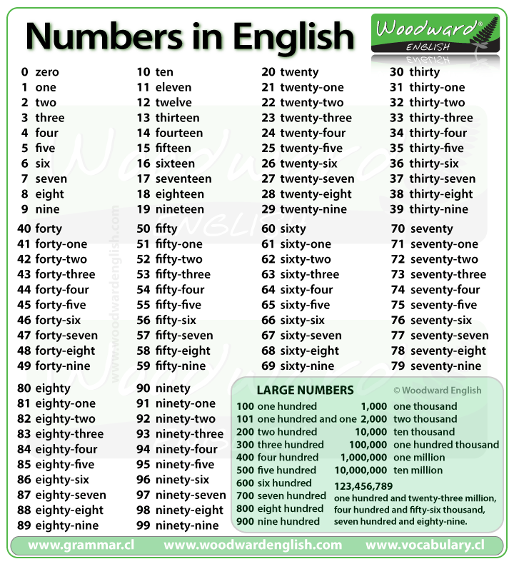
Cardinal numbers
10+20= ?
12+21= ?
29+35= ?
38+40= ?
15+57= ?
Tip! (+) Plus
(=) Equals
F. 56+10= ?
G. 81+12= ?
H. 92+8= ?
I. 14+82= ?
J. 55+33= ?

Slide 5
Tricky words
Football
Book
Cook
Food
Moon
Boot

Slide 6

Tricky words: survey
Do you like football? What’s your favorite team?
What do you like to cook?
What kind of food is healthy?
What’s your favorite book?
Are boots just for winter? Why?
What do you think when you look at the moon?

Slide 7
Vocabulary: Nouns
A man
A woman
A child
A person
A tooth

Slide 8
Matching task
?
?
?
?
?
Women
Who are those in English?
What are those in English?
Teeth
Men
People
Children

Slide 9
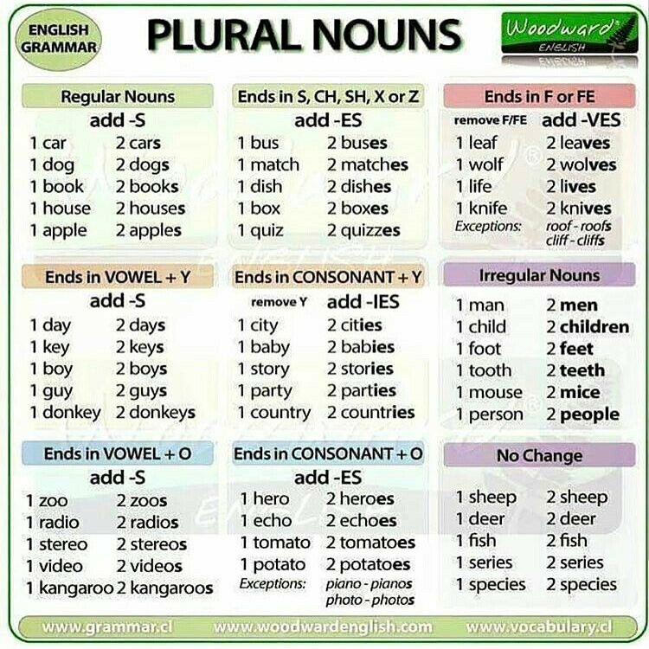
Irregular plural nouns
What does it mean?
Or
What’s the meaning of…?
Wife – Wives
Potato – Potatoes
Goose – Geese
Mouse – Mice
Penny – Pence
Buffalo
Shrimp

Slide 10
Conversation
Video
Sophie: Darling, hi, it’s me.
Daisy: Hi, Mum.
Sophie: Listen, I’m in a bit of a hurry, but can you help me for a minute?
Daisy: Ummm ... yeah.
Sophie: Well, I’m doing a bit of Christmas shopping and I want your advice. Look. I’m here in the market. Wait a second, I’ll put my video on, OK? Listen, what do you think about these for your Uncle Bob?
Daisy: Mmm ... I’ve never seen Uncle Bob in trousers like those, but they are great! Maybe he needs a bit of color in his life?!
Council, B. (n.d.). This, that, these, those. LearnEnglish Teens - British Council. https://learnenglishteens.britishcouncil.org/grammar/beginner-grammar/these-those.

Slide 11
Conversation II
Sophie: I’m not sure ... but maybe you’re right. I mean, they’re pure silk. OK, so you think they’re perfect for Bob?
Daisy: Well, I didn’t say ‘perfect’ exactly, but I’m sure he’ll like them. Wow, that market looks amazing. Lovely and colorful.
Sophie: It’s beautiful, Daisy. I’ll bring you next time for sure.
Daisy: You always say that, Mum!
Sophie: I know, love, but you have school and this is work you know!
Daisy: Yeah, I know. It’s all work, work, work.

Slide 12
Conversation III
Sophie: Daisy, one more question - what about this shirt for Oliver?
Daisy: For Ollie? Yeah, Mum, he’ll love it. No, hold on, what about that one over there, behind you? The one with the flowers on.
Sophie: This one? Really? Do you think it’s Ollie’s style? It’s a bit loud, isn’t it? He usually likes darker colours ... and I’m not sure about the flowers.
Daisy: Oh, he’ll love it, Mum. At least he won’t get lost on a dark night!
Sophie: Yeah, maybe ... he has got some brighter coloured clothes recently. OK then, I’ll get these for Uncle Bob and this shirt for Oliver and you’re getting a surprise!
Daisy: Perfect, Mum! When are you arriving home?
Sophie: I’ll be there on Monday, OK? See you then, love.
Daisy: All right, Mum, see you soon. Take care.

Slide 13
Vocabulary: Lost property
Diaries
Wallets
Watches
Bags
Shoes

Slide 14
Vocabulary: Lost property
Suitcases
Coats
ID cards
Dresses
Cameras
Game: ☺

Slide 15

Reading: Shopping for electronics
True or False
A. The sale is more than two weeks long
B. Laptops are half price
C. You can buy kitchen equipment
D. A printer is normally £100
E. Some computers aren’t in the sale
True
True
False
False
False
Council, B. (n.d.). Beginner A1 reading: LearnEnglish Teens - British Council. Beginner A1 reading | LearnEnglish Teens - British Council. https://learnenglishteens.britishcouncil.org/skills/reading/beginner-a1-reading.

Slide 16

Gap fill
The sale begins on _______.
There is up to _____ off.
There is _____ off all computers.
There is _____ off all printers.
There is _____ off all laptops.
25th April
80%
30%
When does it begin? Or What’s the percentage?
25%
50%

Slide 17

Survey
What words are new for you?
What nouns are easy?
What words are hard?
How do you remember words in English?
Do you use translator or monolingual dictionary?
Think before you act, think twice before you speak. Brown, T.

Slide 18
Speaking
Listening
iTalkuTalk
Listen podcast British Council
English tips

Slide 19


